Slide 1
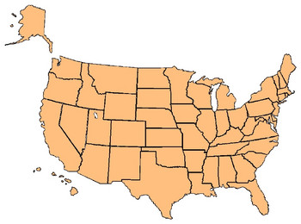
3-11 THE SIMPLE PRESENT: ASKING INFORMATION
QUESTIONS WITH WHERE
Where do they live?
Do they live in Baltimore?
*

Slide 2
3-11 THE SIMPLE PRESENT: ASKING INFORMATION
QUESTIONS WITH WHERE
QUESTION SHORT ANSWER
(a) Do they live in Baltimore?
Yes, they do.
No, they don’t.
(b) Where do they live?
In Baltimore.

Slide 3
3-11 THE SIMPLE PRESENT: ASKING INFORMATION
QUESTIONS WITH WHERE
QUESTION SHORT ANSWER
(c) Does Alexi live in Moscow?
Yes, he does.
No, he doesn’t.
(d) Where does he live?
In Cape Town.

Slide 4
3-11 THE SIMPLE PRESENT: ASKING INFORMATION
QUESTIONS WITH WHERE
(WHERE)
+
DO/DOES
+
SUBJECT
+
MAIN VERB
(a) in Baltimore
Do
they
live
?
(b) Where
do
they
live
?
(c) in Moscow
Does
Alexi
live
?
(d) Where
does
he
live
?

Slide 5
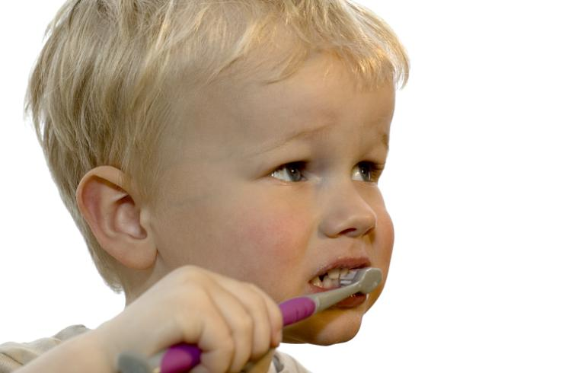
3-11 Let’s Practice
Question:
Answer: In the bathroom.
Where does he brush his teeth?
(He brushes his teeth in the bathroom.)

Slide 6
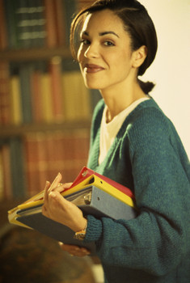
3-11 Let’s Practice
Question:
Answer: Yes, she does.
Does Lucy like to read at the library?
(Lucy likes to read at the library.)

Slide 7
3-13 SUMMARY: INFORMATION QUESTIONS WITH BE
AND DO
Q-WORD + DO + SUBJECT + MAIN VERB
(f) Where does she live?
She lives in Belgium.
(g) What time does school start?
It starts at 9:00 A.M.
(h) What does she play?
She plays tennis.
(i) When do you study?
I study at night.

Slide 8
3-13 Let’s Practice
is are does do
do
Where ____ they buy food?

Slide 9
3-13 Let’s Practice
is are does do
does
What time _____ the train leave?

Slide 10
3-13 Let’s Practice
is are does do
is
When ____ your test?

Slide 11
3-13 Let’s Practice
is are does do
are
What ____ their names?

